Slide 1
Introduction to Data Analytics
By Amit Kumar
202310101150190

Slide 2

Concepts
Data Analytics Basics
Tools for Data Analytics
Key Libraries ○ Pandas ○ NumPy ○ Matplotlib
IOT project

Slide 3

#1. What is Data? Can it provide insights for real-life decision-making?
Questions for this session

Slide 4

DATA*

Slide 5
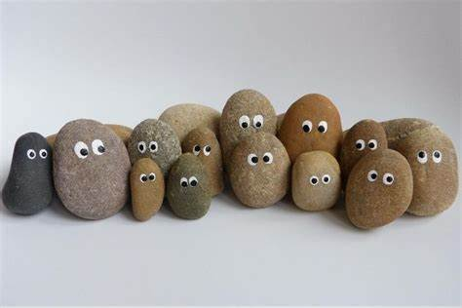
Data
Raw and unorganized facts and statistics
Requires processing to extract meaning
Meaningless
Eg; A, 34, 911, 9.8 etc.

Slide 6
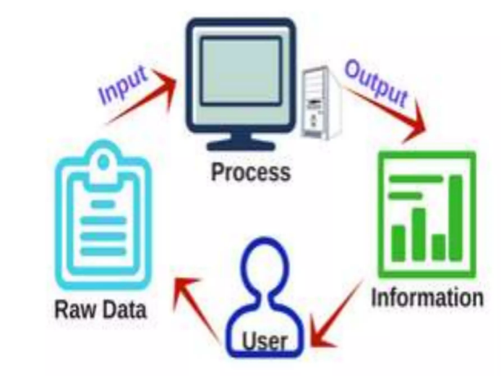
Data VS Data Analytics
Process of transforming data into actionable insights
Uses statistical and computational techniques
Examples: Identifying sales trends, customer behavior analysis
Eg: Average temperature is 20°C

Slide 7
#2. What is Data Analytics?It’s types?
Questions for this session

Slide 8

Data Analytics
The process of collecting, processing, and analyzing data to generate insights.
Helps organizations make data-driven decisions.
Applies statistical, mathematical, and computational techniques.

Slide 9
Types of Data Analytics
Descriptive Analytics
Summarizes past data to understand what has happened.
Diagnostic Analytics
Investigates why something happened.
Predictive Analytics
Forecasts future outcomes based on past data.
Prescriptive Analytics
Suggests actions based on predictions.

Slide 10
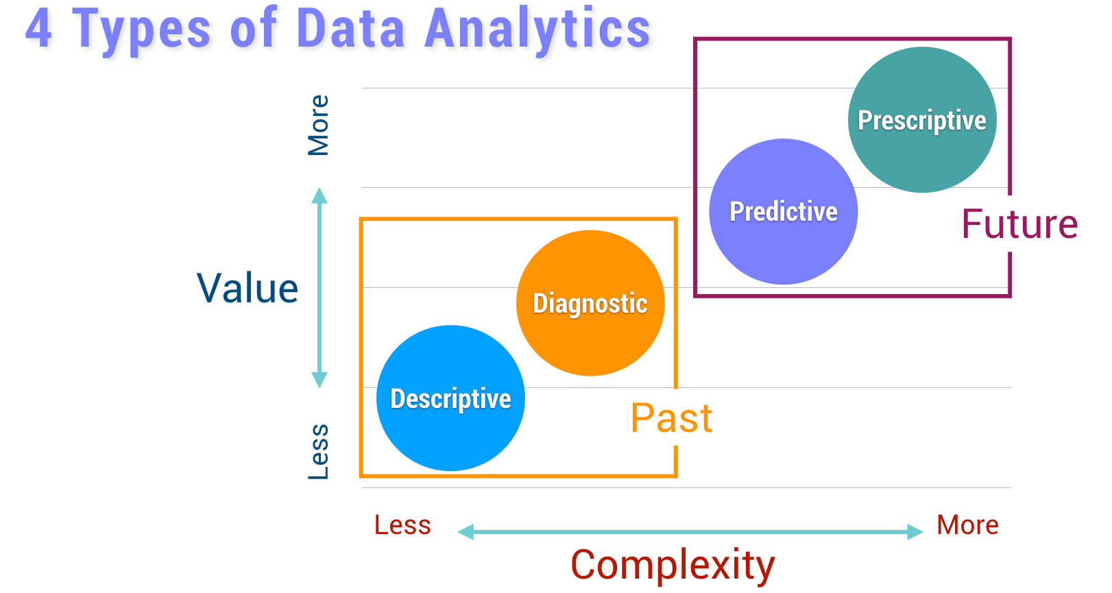
Types of Data Analytics

Slide 11
#2. Why Use Python for Data Analytics?
Questions for this session

Slide 12
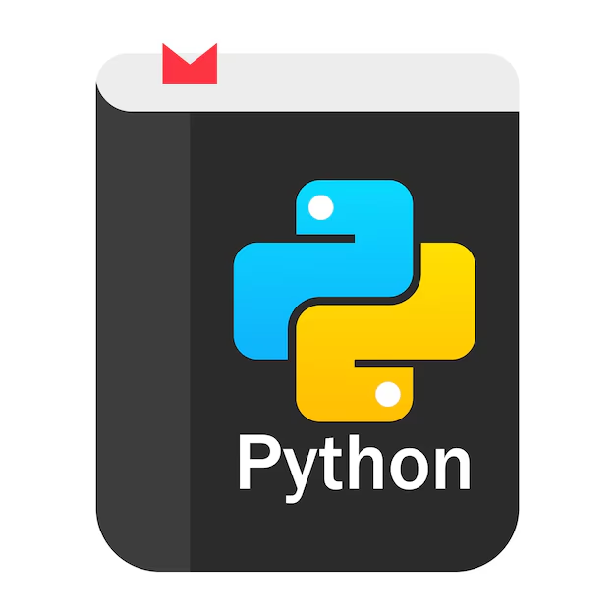
Python for Data Analytics
Python is widely used due to its simplicity and readability.
Extensive libraries support data manipulation and machine learning.
Integrates well with other languages and technologies.
Popular for prototyping, scalability, and a large community.

Slide 13

Introduction to Pandas and its Use Cases
Pandas
Python library for data manipulation and analysis
Provides data structures like DataFrames and Series
Essential for handling structured data
Examples
Loading and manipulating data from CSV, Excel, etc.
Data cleaning, aggregation, and merging

Slide 14

NumPy
Python library for numerical computing and array operations
Provides powerful multi-dimensional array objects
Essential for scientific computing and mathematics
Examples
Mathematical operations on arrays and matrices
Linear algebra, statistical functions, and random number generation

Slide 15
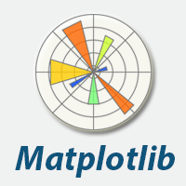
Matplotlib
Python library for creating static visualizations
Provides tools for plotting graphs, charts, and figures
Essential for data visualization and scientific plotting
Examples
Line plots, scatter plots, histograms
Customizable charts with labels, colors, and styles

Slide 16
#3. IOT project
Questions for this session

Slide 17
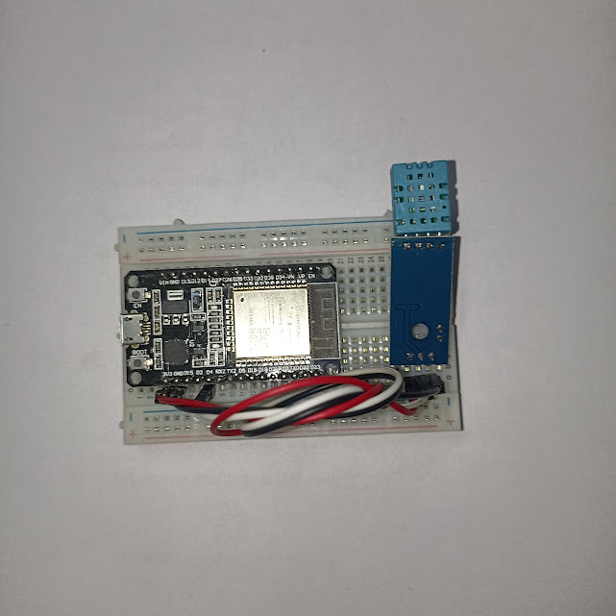
Doing Data Analytics on Temperture in Home
Objective: To monitor temperature differences around my home

Slide 18
Requirement:
ESP 32 Dev Module
DHT11 Sensor
Arduino IDE
Google sheet
App script
Google Collab

Slide 19
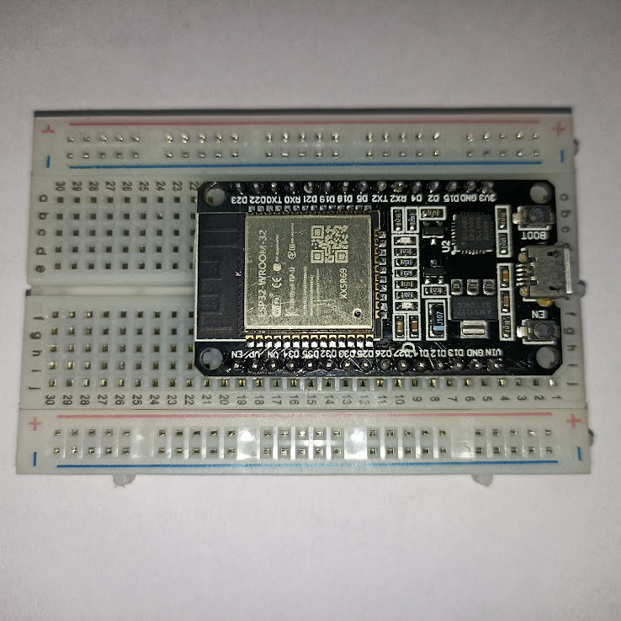
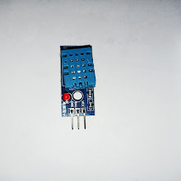
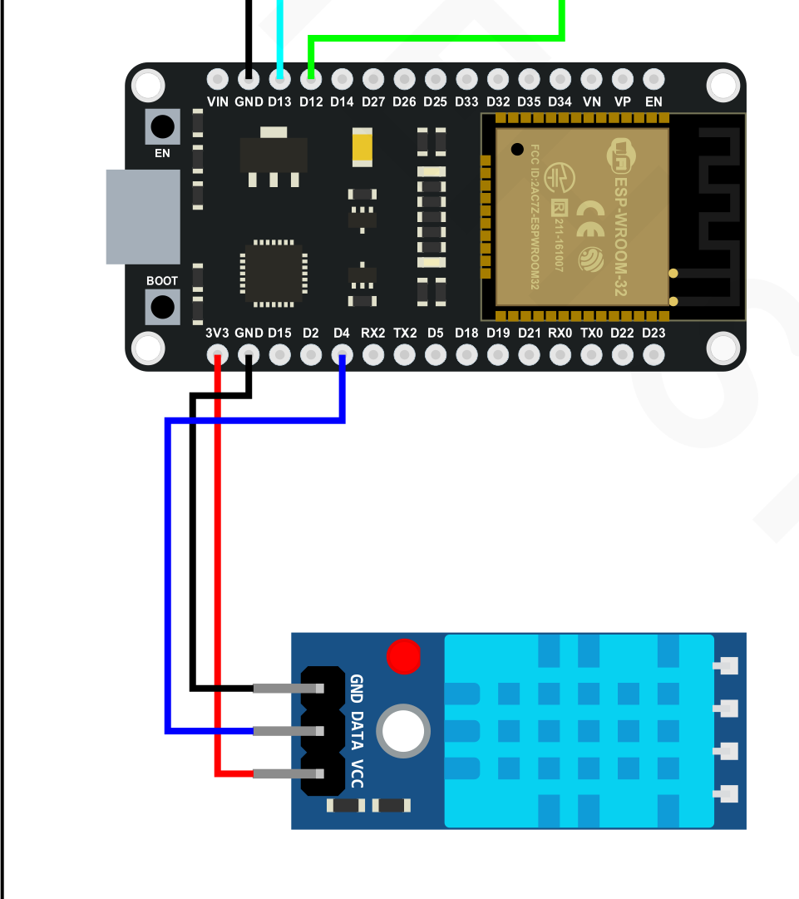
ESP32 and DHT11

Slide 20
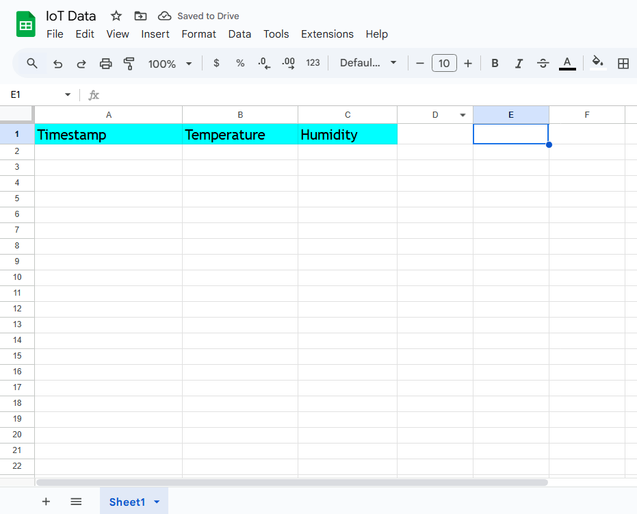
Google Sheet

Slide 21
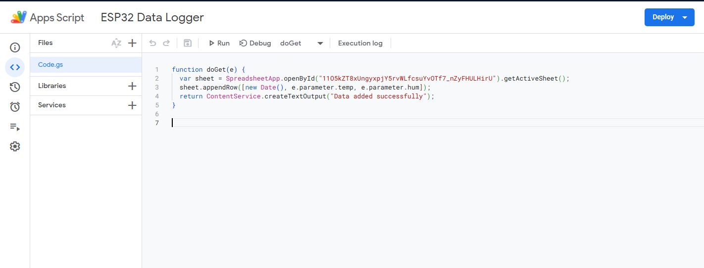
App Script

Slide 22
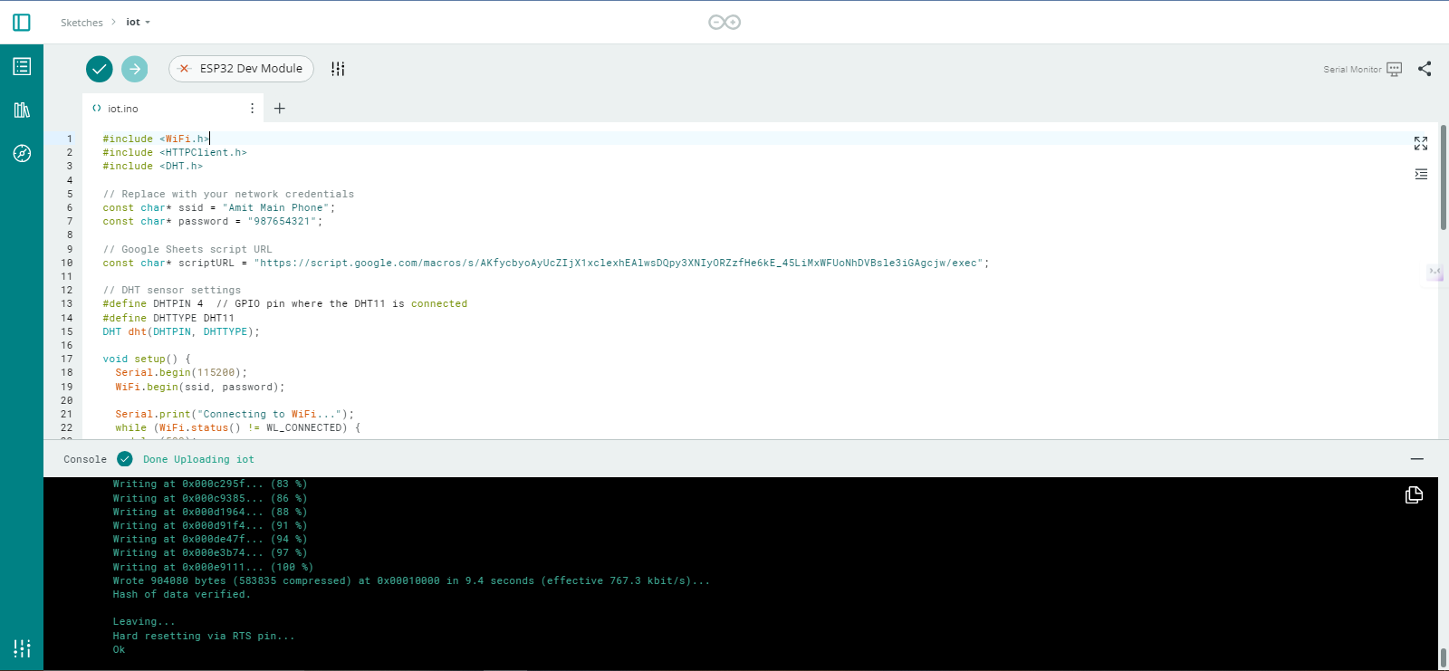
Arduino IDE

Slide 23
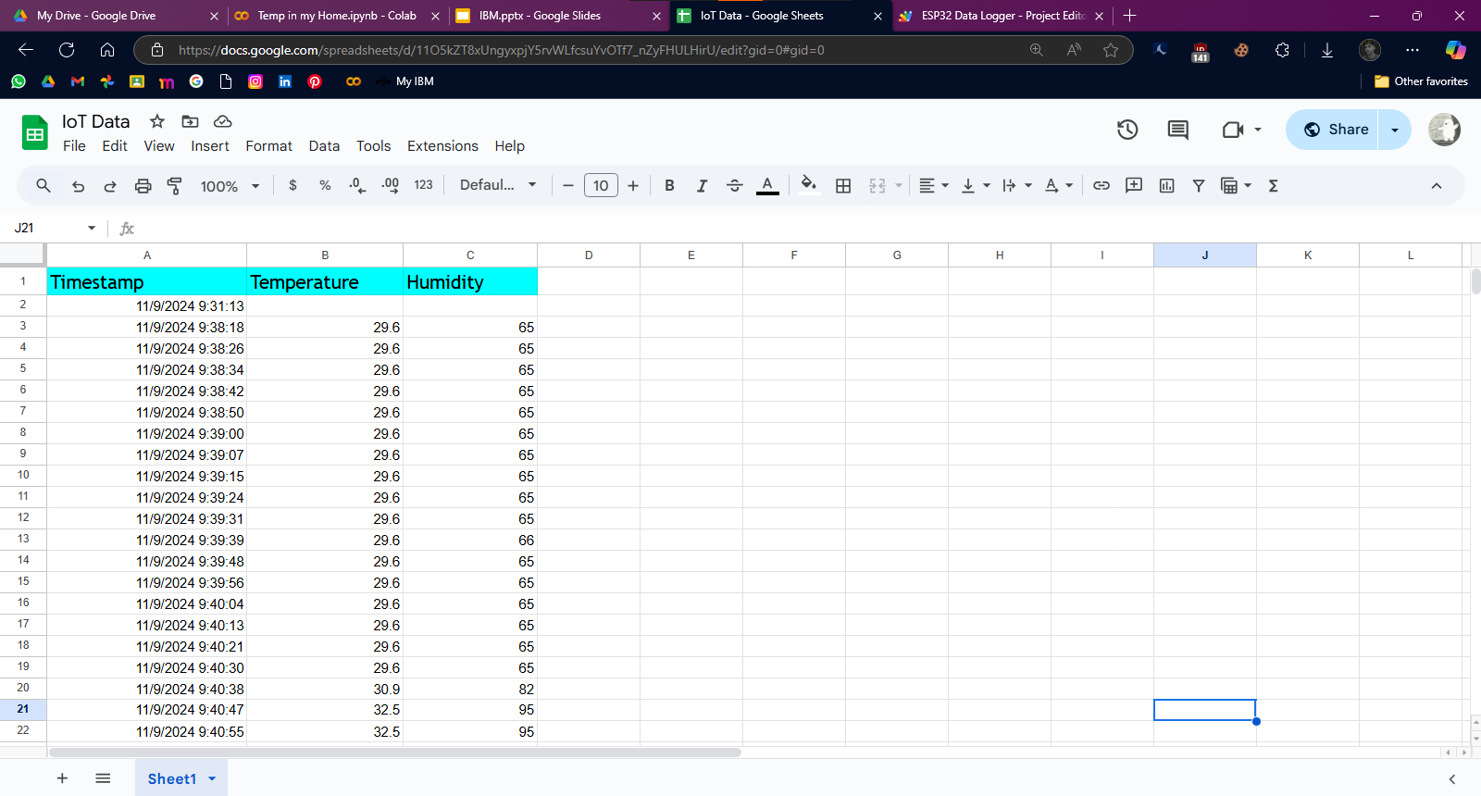
Google Sheet

Slide 24
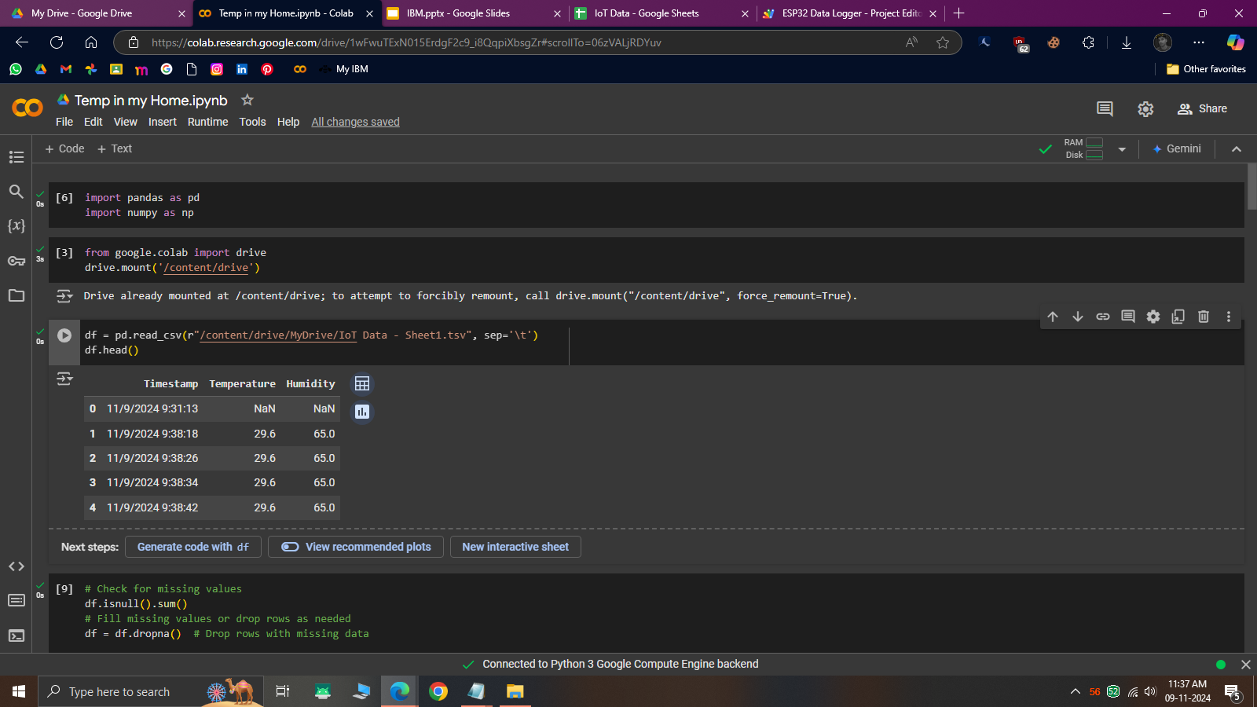
Google Collab

Slide 25
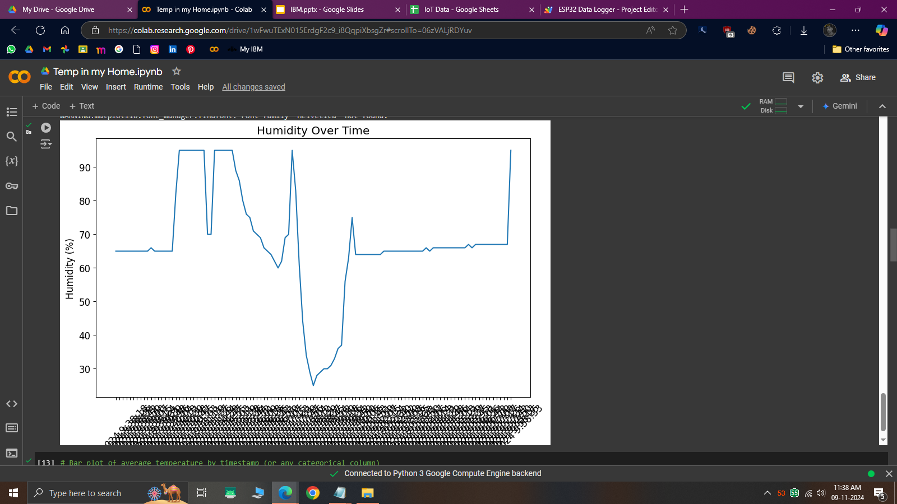

Slide 26
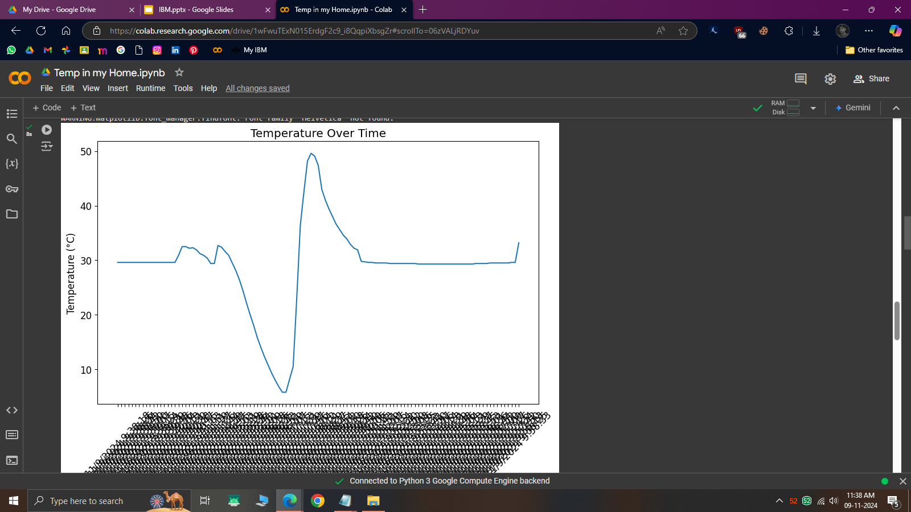

Slide 27
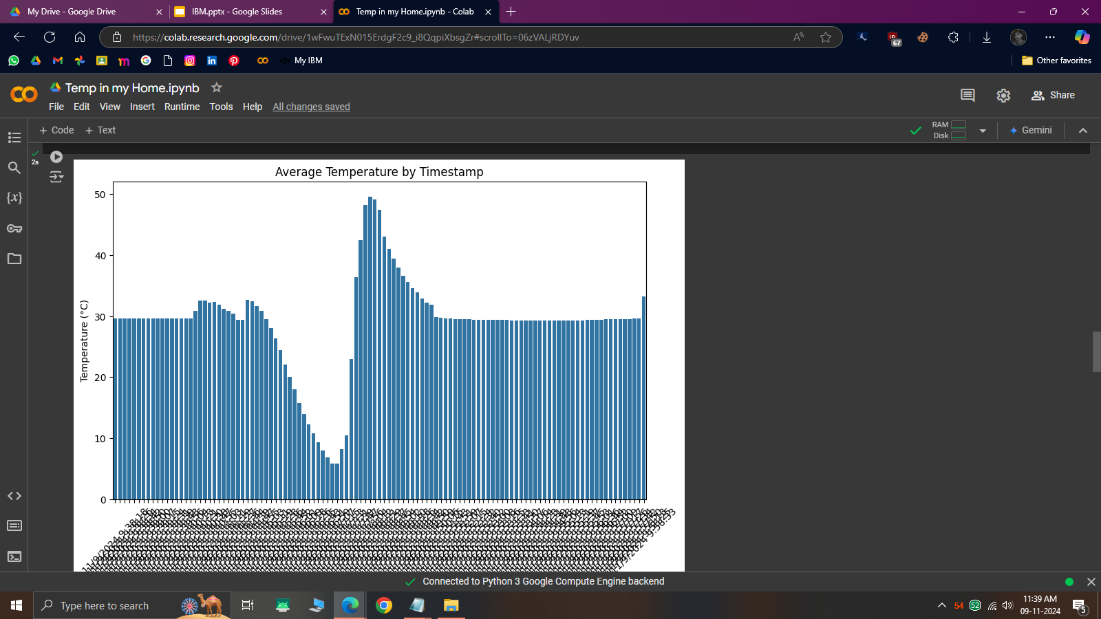

Slide 28
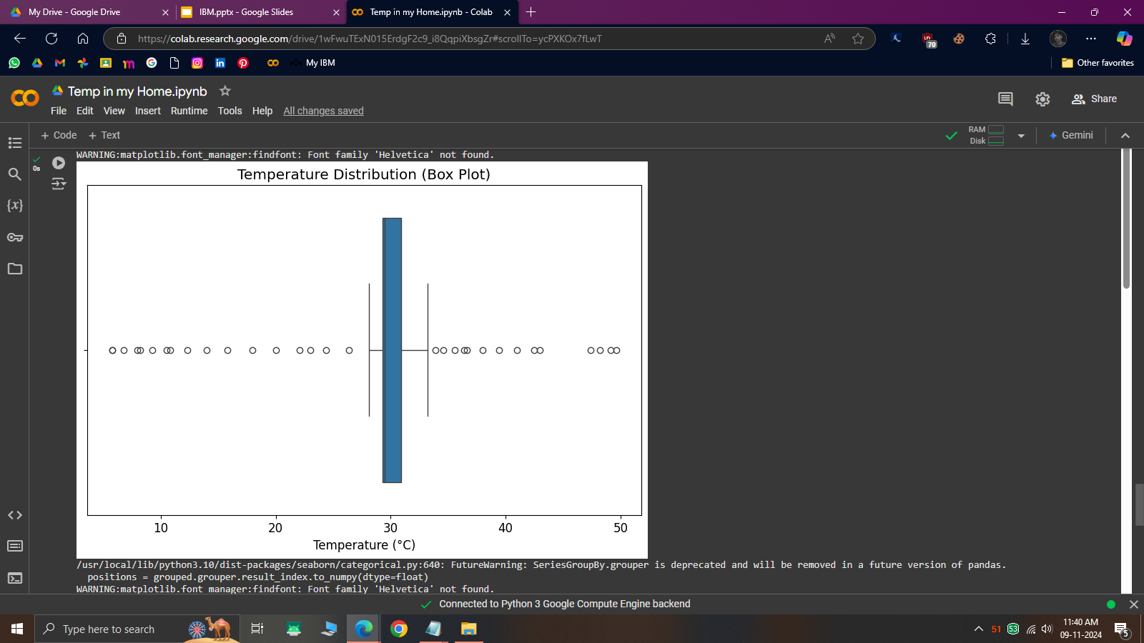

Slide 29
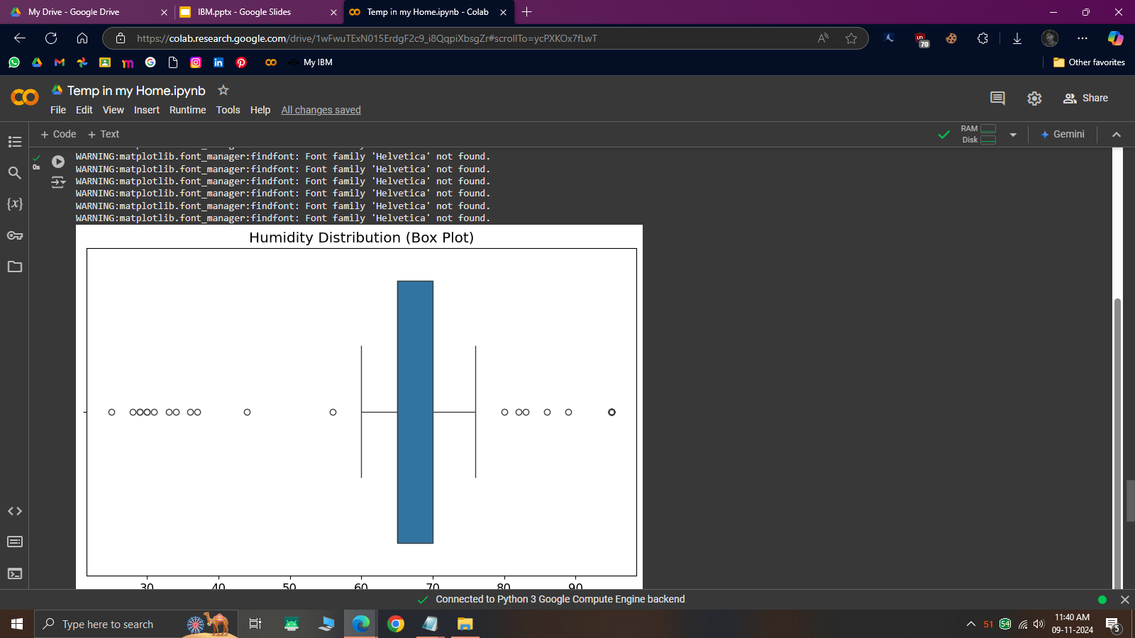

Slide 30
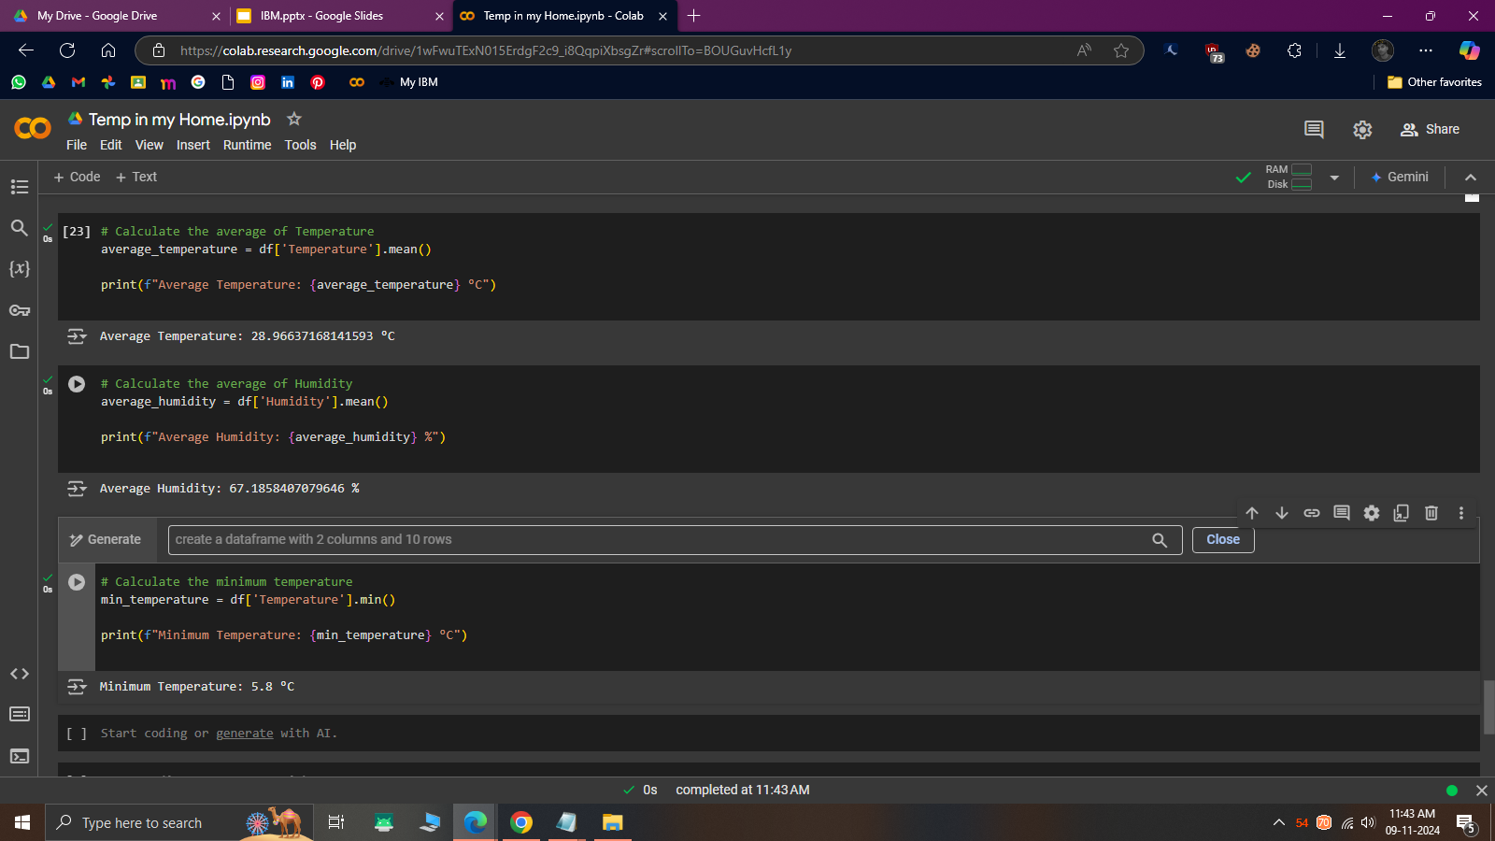

Slide 31
#3. Amit do you live in shimla? how can your home temp can go to 5.8℃?
Questions for this session

Slide 32
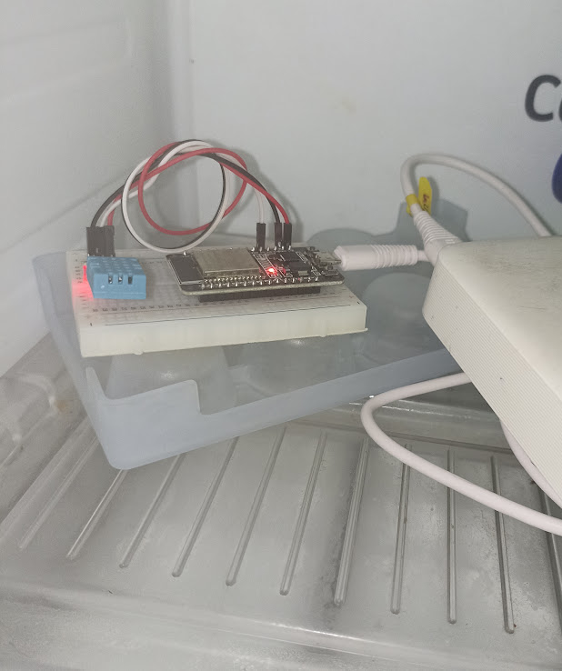

To check the accuracy of DHT11

Slide 33


